Slide 1
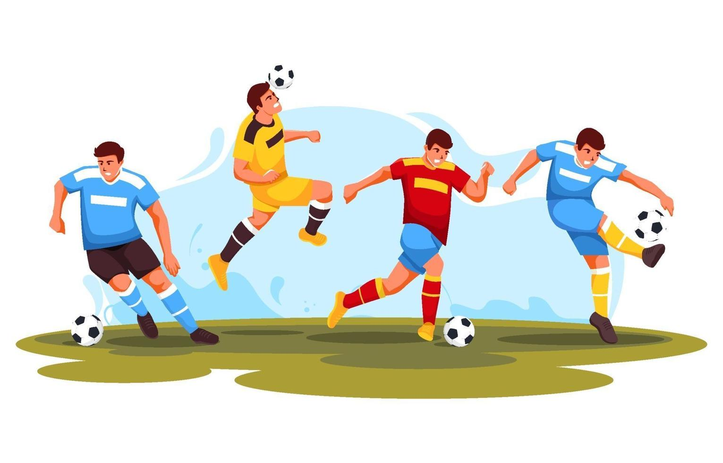
My Favorite footballer
Khaled Mahmud Shihab
Sec:Ae
Roll:0112330871
Serial:15

Slide 2
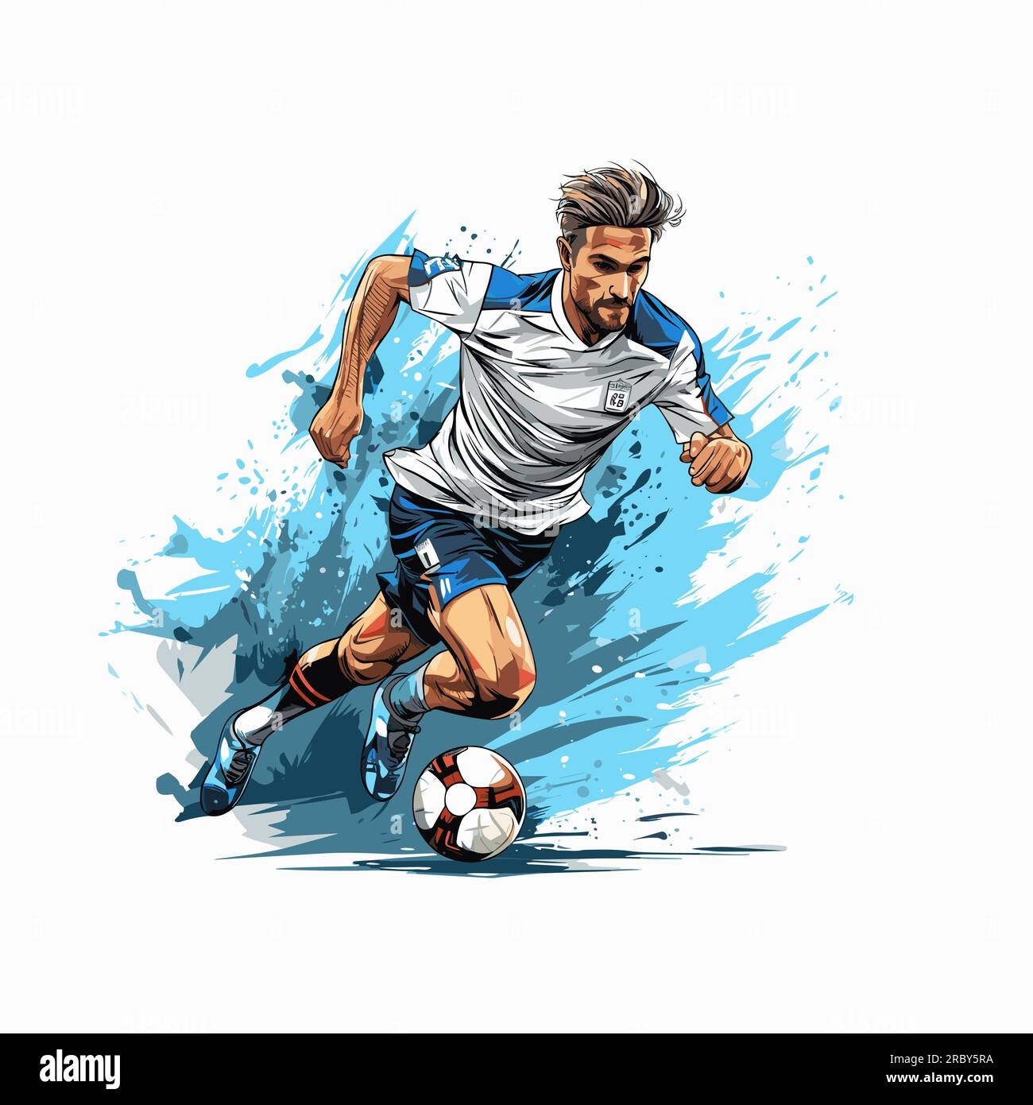
Let us know About football first
Game of two teams, eleven players each, battling out to score goals and claim victory.

Slide 3
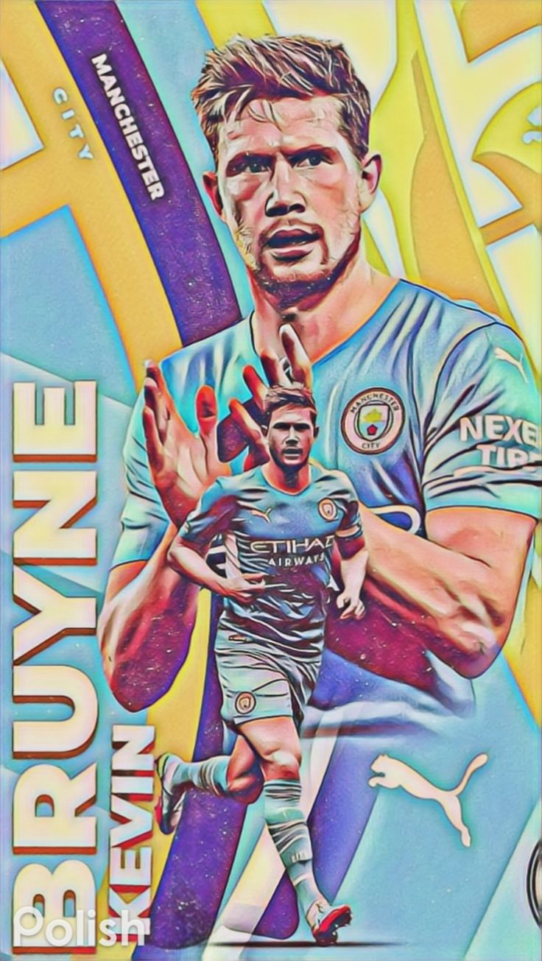
Among All the ballers my favorite Kevin DE BRuyne
Early Days
Struggling period
Rise
Eye Soothing Pass
Intelligence In Game
Leadership
QNA

Slide 4
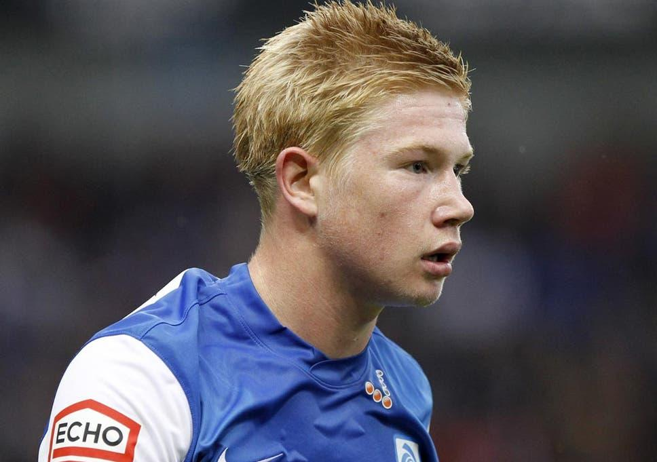
Early years
KDB began his professional senior career at Genk, where he was a regular player when they won the 2010–11 Belgian Pro League.
His youthful talent caught the attention of top clubs across Europe.

Slide 5
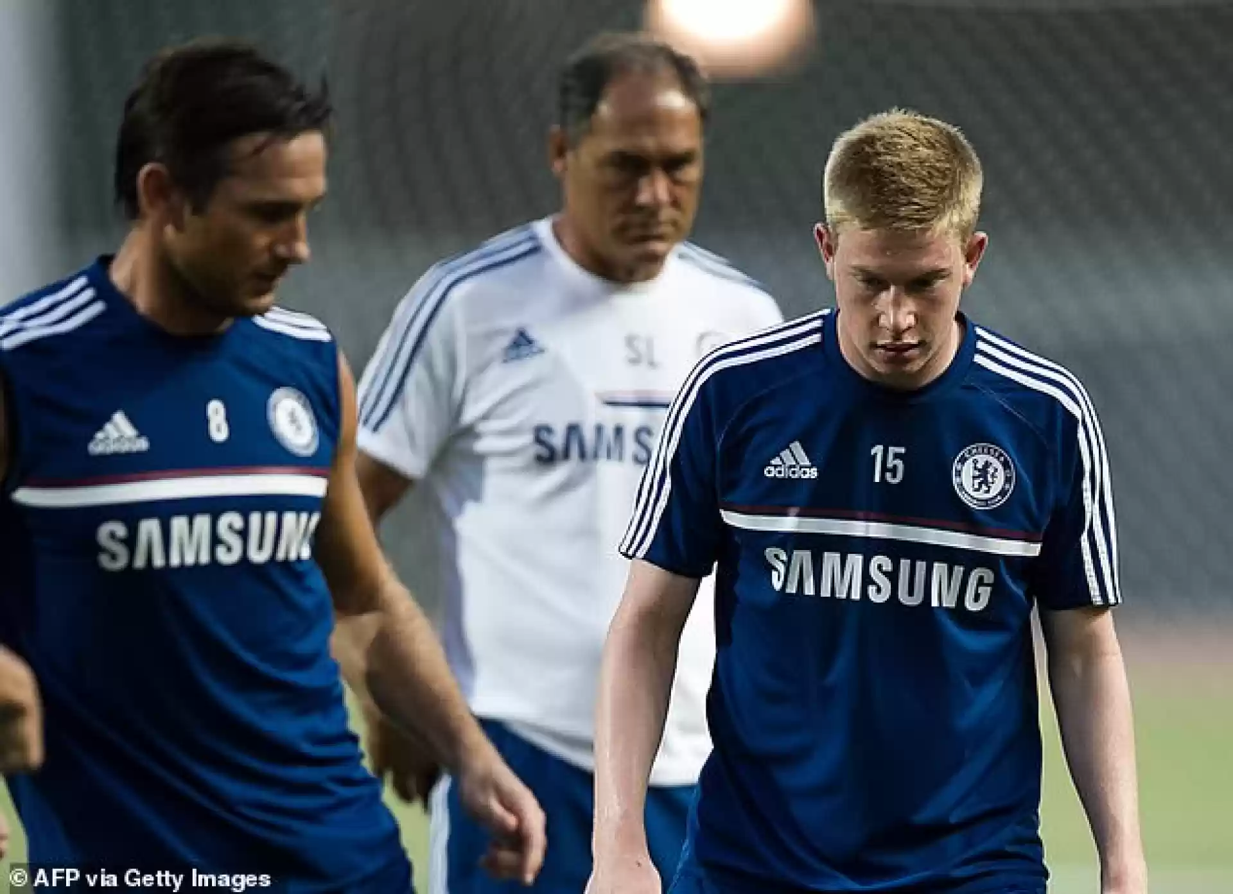
Struggling period
In 2012 Chelsea signed him but for them he was not creative enough to play at Chelsea. So they sold him to Wolfsburg; A team which narrowly missing relegation every season.

Slide 6
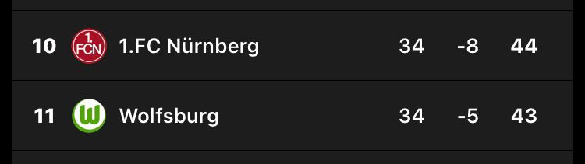
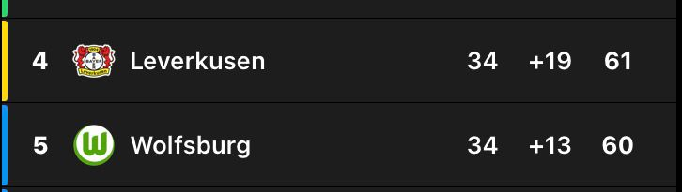
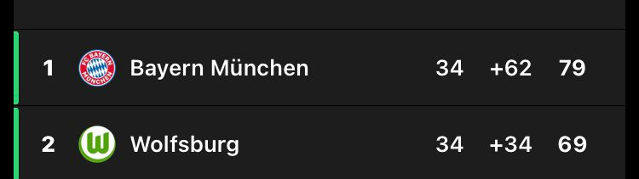
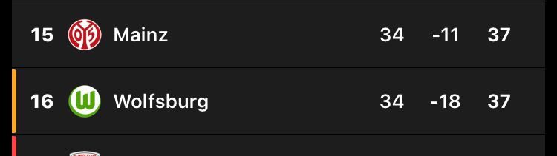
Rise⬆️
After joining Wolfsburg He scored 20 important goals.
Voted for 2014/15 player of the season
In 2014/15 season he assist 20 goals which was most of any players in Europe top league.
Wolfsburg win the “German Club” their first ever cup tittle
Wolfsburg Got second in the Bundesliga
Then He joined Manchester City
Rest is History

Slide 7
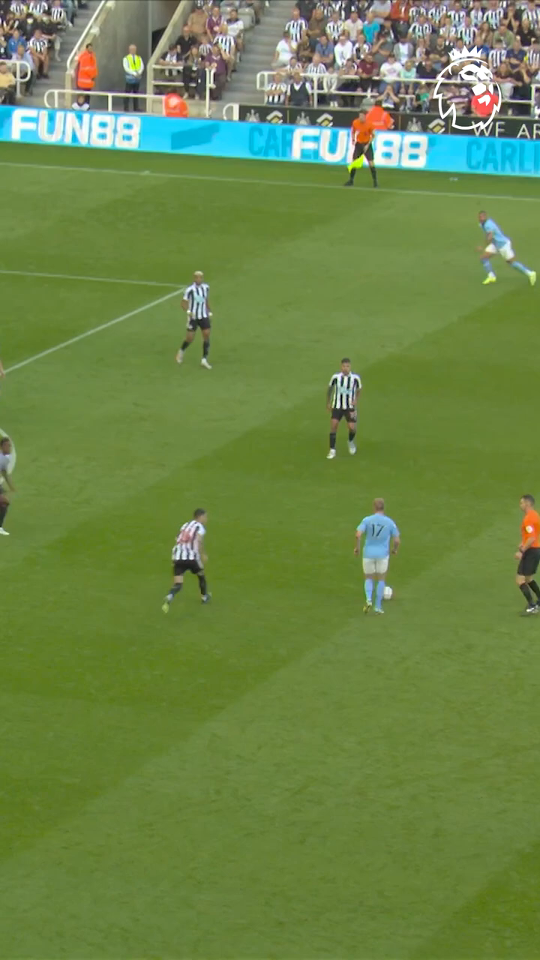
Eye soothing passes
De Bruyne's masterful passing is a defining aspect of his gameplay. Whether it's short, long, or through balls, his precision and technique set him apart as one of the best passers in the game.

Slide 8
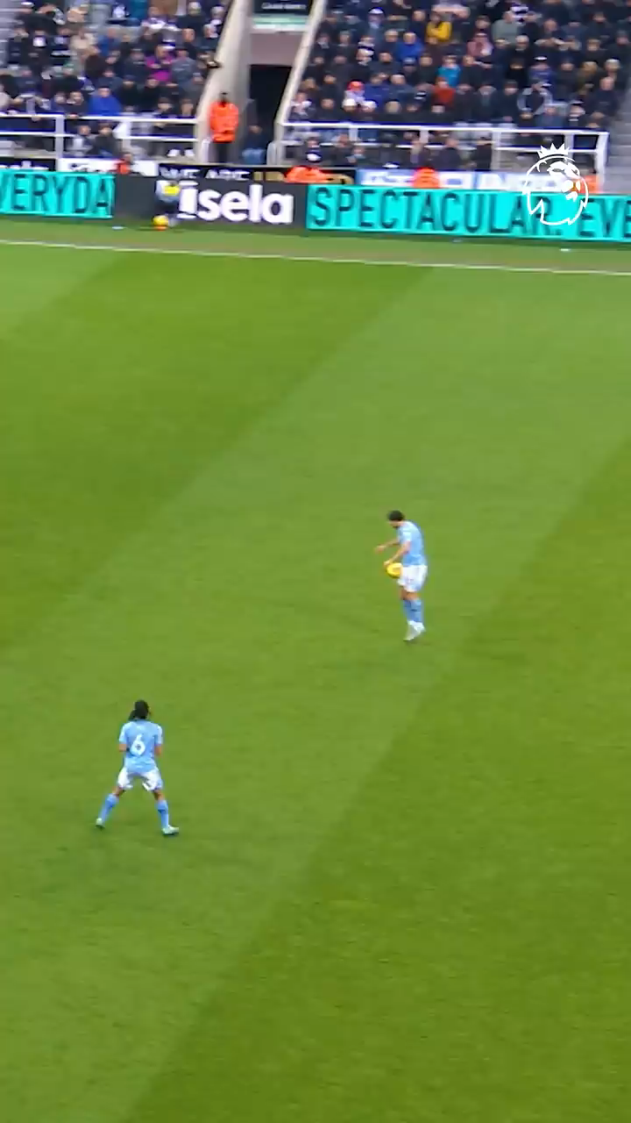
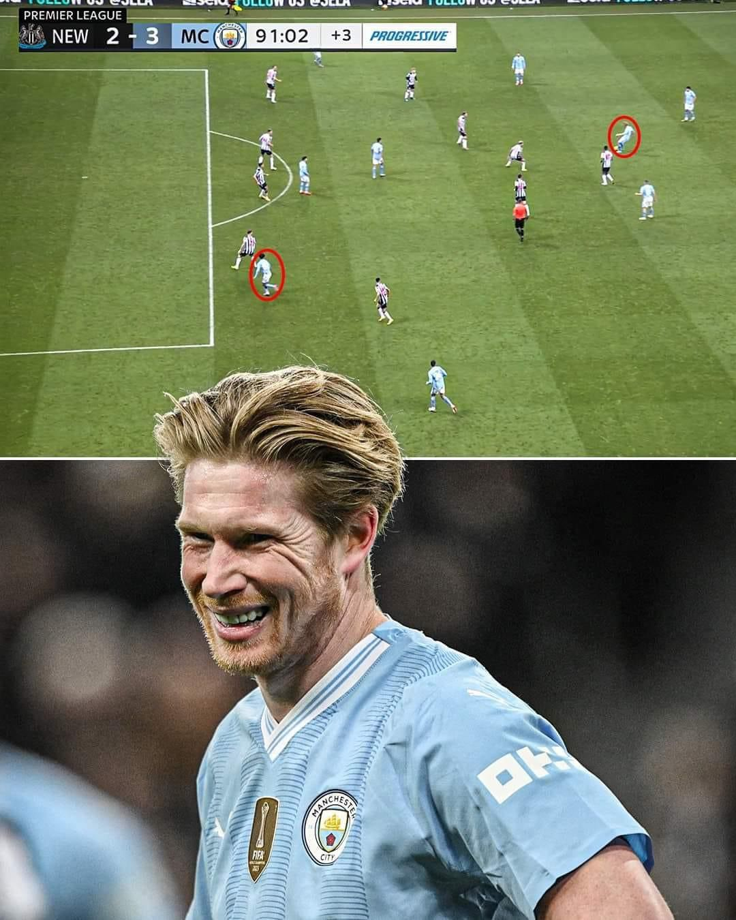
Intelligence in game
De Bruyne is so special because he sees things on the pitch that no one else can.

Slide 9
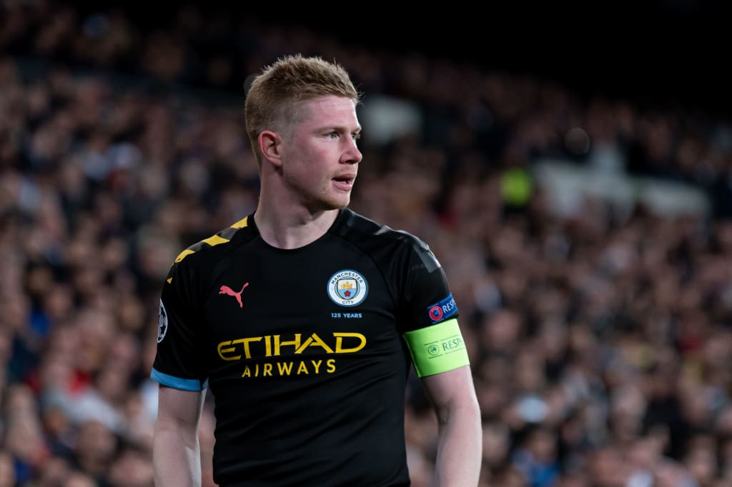
leadership
De Bruyne is known for his leadership qualities on and off the field. He often takes charge during matches, directing his teammates and leading by example through his work rate and determination.

Slide 10
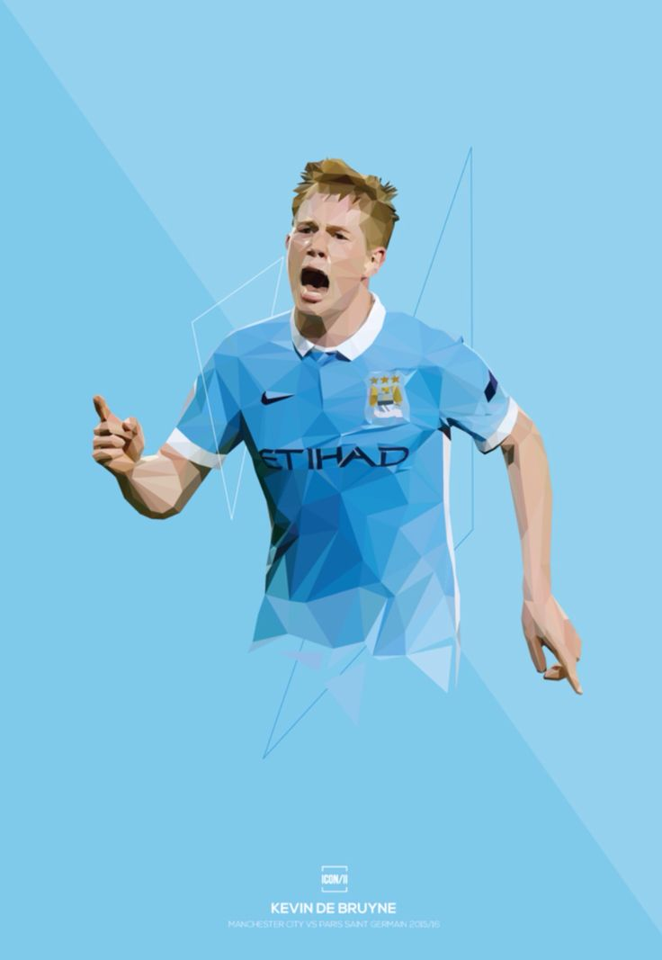
Conclusion
Kevin De Bruyne's brilliance on the football field is a result of his exceptional vision, versatile playmaking, masterful passing, and influential leadership. De Bruyne's influence on the game is truly remarkable.

Slide 11
THANKS!

Slide 12
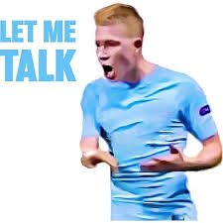
Qna
ASK

